Slide 1

CS380: Computer Graphics
Texture Mapping
Sung-Eui Yoon
(윤성의)
Course URL:
http://sglab.kaist.ac.kr/~sungeui/CG
Notes:
1

Slide 2
Class Objectives
Texture mapping overview
Texture filtering
Various applications of texture mapping
Related chapter of my book
  Chapter 9 “Texture”

Slide 3
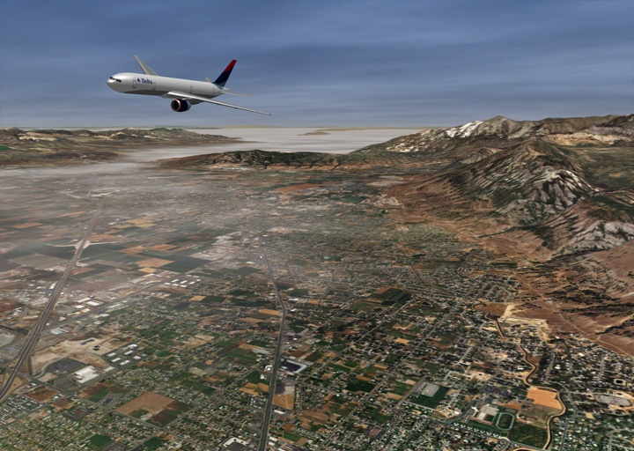
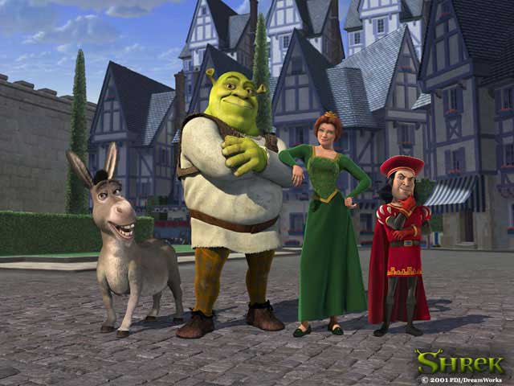
Texture Mapping
Requires lots of geometry to fully represent complex shapes of models
Add details with image representations
Excerpted from MIT EECS 6.837, Durand and Cutler

Slide 4
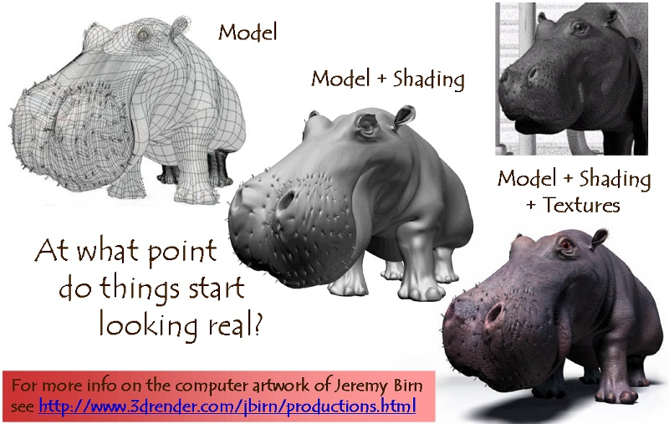
The Quest for Visual Realism

Slide 5
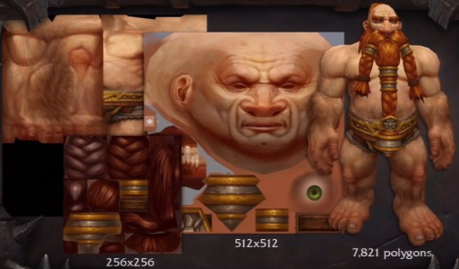
Texture Mapping
From MMO-champion

Slide 6
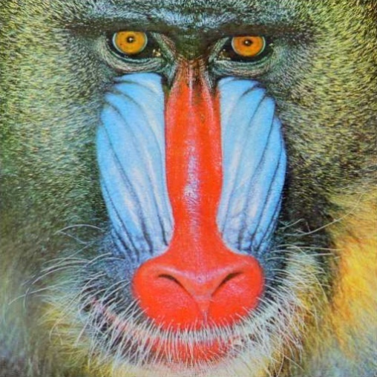
Texture Maps in OpenGL
(x₄,y₄)
(u₄,v₄)
(x₃,y₃)
(u₃,v₃)
Specify normalized texture coordinates at each of the vertices (u, v)
Texel indices
(s,t) = (u, v) ⋅ (width, height)
(x₁,y₁)
(u₁,v₁)
(x₂,y₂)
(u₂,v₂)
glBindTexture(GL_TEXTURE_2D, texID)
glBegin(GL_POLYGON)
glTexCoord2d(0,1); glVertex2d(-1,-1);
glTexCoord2d(1,1); glVertex2d( 1,-1);
glTexCoord2d(1,0); glVertex2d( 1, 1);
glTexCoord2d(0,0); glVertex2d(-1, 1);
glEnd()

Slide 7
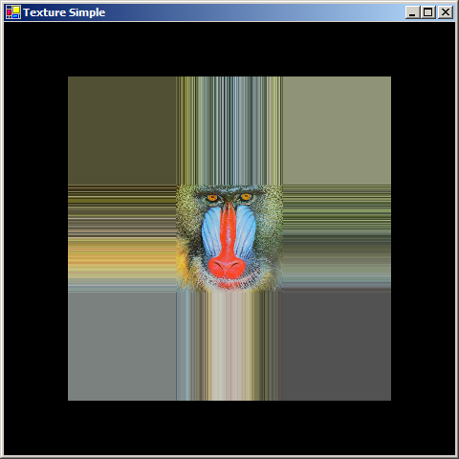
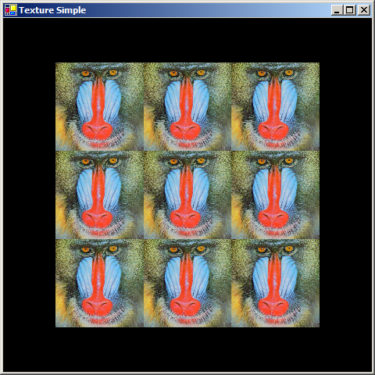
Wrapping
The behavior of texture coordinates outside of the range [0,1) is determined by the texture wrap options.
glTexParameteri(GL_TEXTURE_2D, GL_TEXTURE_WRAP_S, wrap_mode )
glTexParameteri(GL_TEXTURE_2D, GL_TEXTURE_WRAP_T, wrap_mode )
GL_CLAMP
GL_REPEAT
Notes:
How do we get repeat?

Slide 8
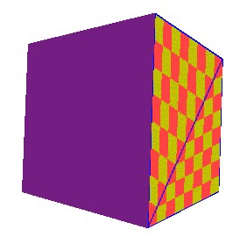
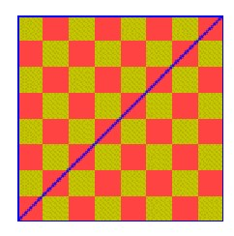
Linear Interpolation of Texture Coordinates
Simple linear interpolation of u and v over a triangle in a screen space leads to unexpected results
  Distorted when the triangle’s vertices do not have the same depth
  Perspective-correct interpolation (interpolation in the object space) is implemented

Slide 9
Sampling Texture Maps
The uniform sampling pattern in screen space cooresponds to some sampling pattern in texture space that is not necessarily uniform
Texture space
Screen space
y
t
x
s

Slide 10
Sampling Density Mismatch
Sampling density in texture space rarely matches the sample density of the texture itself
Oversampling
(Magnification)
Undersampling
(Minification)

Slide 11
Handling Oversampling
How do we compute the color to assign to this sample?
sample
texture

Slide 12
Handling Oversampling
How do we compute the color to assign to this sample?
Nearest neighbor – take the color of the closest texel
texture

Slide 13

Handling Oversampling
How do we compute the color to assign to this sample?
Nearest neighbor – take the color of the closest texel
Bilinear interpolation
texture

Slide 14
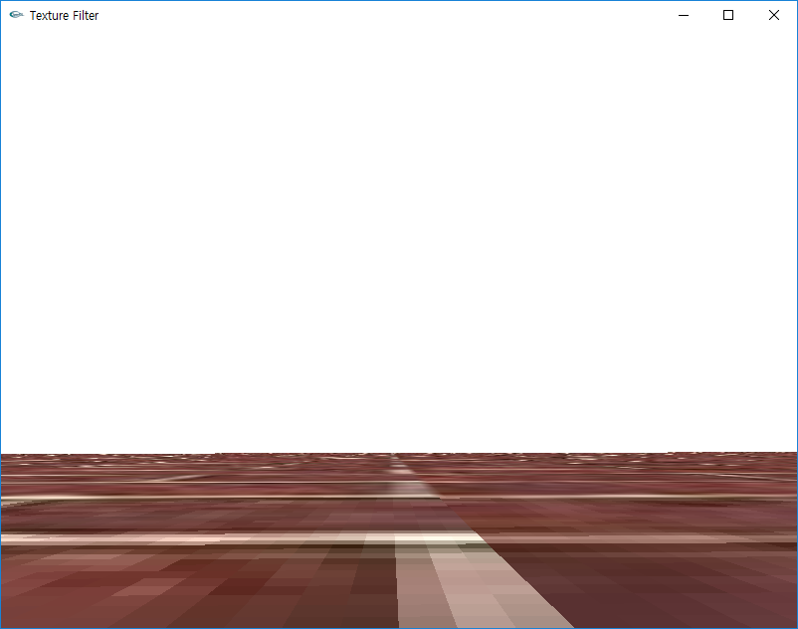



Visual Comparison
Mag. filter: nearest
Min. filter: linear
Mag. filter: linear
Min. filter: linear
Original texture
Mag. filter: linear
Min. filter: mipmap

Slide 15
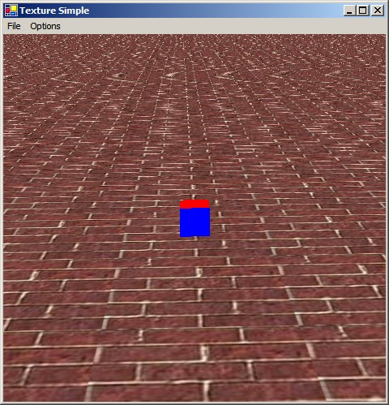
Undersampling
Details in the texture tend to pop (disappear and reappear)
  Mortar (white substances) in the brick
High-frequency details lead to strange patterns
  Aliasing

Slide 16
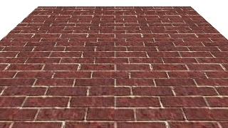
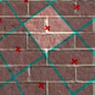
Spatial Filtering
To avoid aliasing we need to prefilter the texture to remove high frequencies
  Prefiltering is essentially a spatial integration over the texture
  Integrating on the fly is expensive: perform integration in a pre-process
Samples and
their extents
Proper filtering removes aliasing

Slide 17
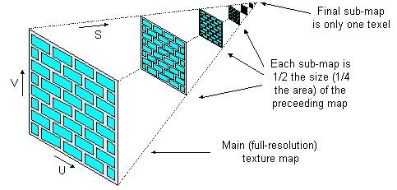
MIP Mapping
MIP is an acronym for the Latin
phrase multium in parvo, which
means "many in one place"
  Constructs an image pyramid
  Each level is a prefiltered
  version of the level below
  resampled at half the frequency
While rasterizing use the level with the sampling rate closest to the desired sampling rate
  Can also interpolate between pyramid levels
How much storage overhead is required?
Notes:
4/3 = epsilon_{i=0} (1/4)^I = 1/(1 – ¼) = 4/3

Slide 18
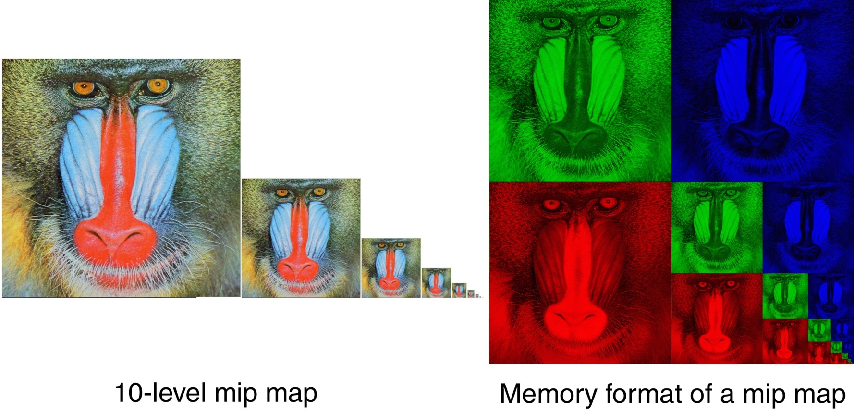
Storing MIP Maps
One convenient method of storing a MIP map is shown below
  It also nicely illustrates the 1/3 overhead of maintaining the MIP map

Slide 19
Finding the MIP Level
Use the projection of a pixel in screen into texture space to figure out which level to use

Slide 20
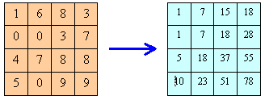




Summed-Area Tables
Another way performing the prefiltering integration on the fly
Each entry in the summed area table is the sum of all entries above and to the left:
$$x_{0}$$
$$x_{1}$$
What is the sum of the
highlighted region?
$$y_{0}$$
$$y_{1}$$
Divide out area (y₁ – y₀)(x₁ – x₀)

Slide 21
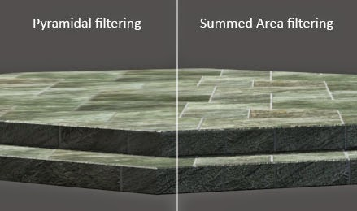
Summed-Area Tables
How much storage does a summed-area table require?
Does it require more or less work per pixel than a MIP map?
Can be implemented in a fragment shader
Created by Denny
Notes:
Less storage, but more resolution
more work – 4 texture fetches – still have to do size estimation
box filter
can see the results of isotropic filtering

Slide 22
Texture Filtering in OpenGL
Automatic creation
gluBuild2DMipmaps(GL_TEXTURE_2D, GL_RGBA, width, height,
GL_RGBA, GL_UNSIGNED_BYTE, data)
Filtering
glTexParameteri(GL_TEXTURE_2D, GL_TEXTURE_MAG_FILTER, filter )
glTexParameteri(GL_TEXTURE_2D, GL_TEXTURE_MIN_FILTER, filter )
where filter is:
GL_NEAREST
GL_LINEAR
GL_LINEAR_MIPMAP_LINEAR
GL_NEAREST_MIPMAP_NEAREST
GL_NEAREST_MIPMAP_LINEAR
GL_LINEAR_MIPMAP_NEAREST
inter-level
intra-level

Slide 23
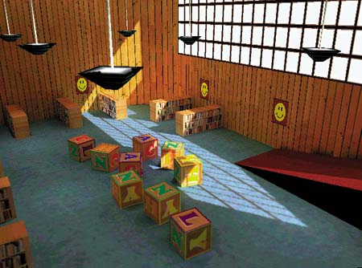
Uses of Texture Maps
Texture maps are used to add complexity to a scene
  Easier to paint or capture an image than geometry
Model light
Model geometry, etc
One of key techniques to overcome various problems of rasterization techniques!

Slide 24
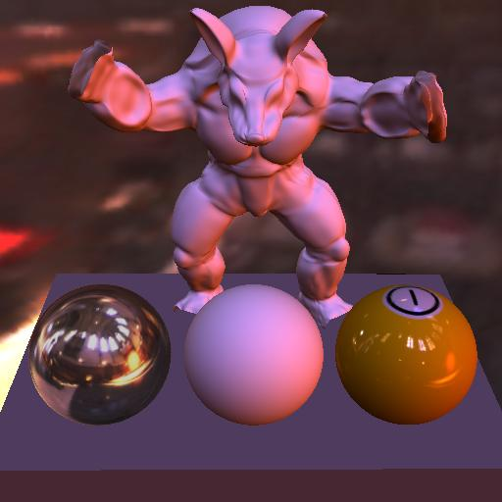
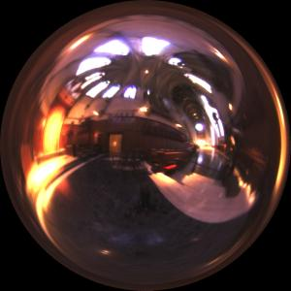
Modeling Lighting
Light maps
  Supply the lighting directly
  Good for static environments
Projective textures
  Can be used to simulate a spot light
  Shadow maps
Environment maps
  A representation of the scene around an object
  Good for reflection

Slide 25
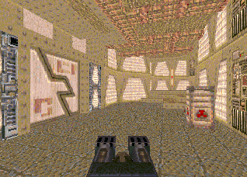
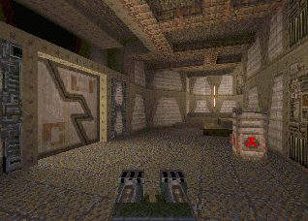

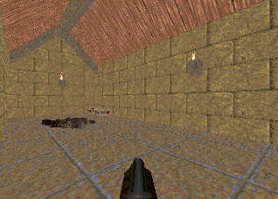
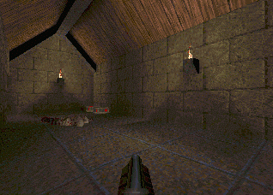
Light Maps in Quake
Light maps are used to store pre-computed illumination
Textures Only
Textures & Light Maps
 | Texture Maps | Light Maps
Data | RGB | Intensity
Resolution | High | Low
Light map image by Nick Chirkov

Slide 26
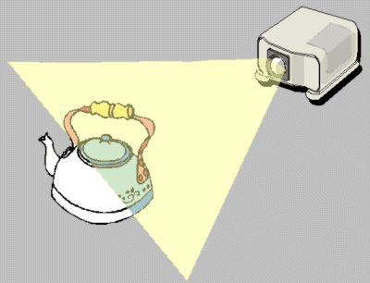
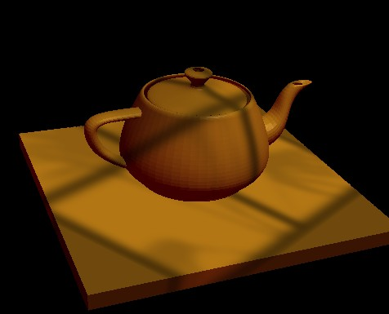
Projective Textures
Treat the texture as a slide in a projector
  A good model for shading variations due to illumination (cool spotlights)
Projectors work like cameras in reverse
  Camera: color of point in scene → color of corresponding pixel
  Projector: color of pixel → color of corresponding point in the scene

Slide 27
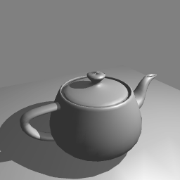
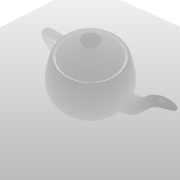
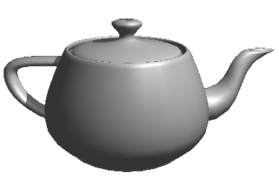
Shadow Maps
Use the depth map in the light view to determine if sample point is visible
Depth map from eye
Depth map from light
Point in shadow
visible to the eye, but not visible to the light

Slide 28
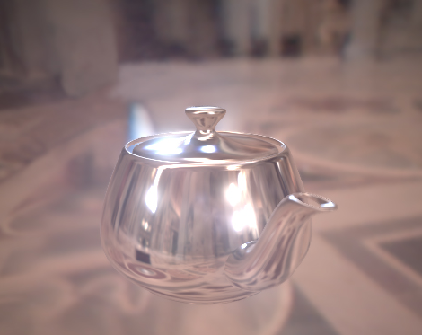


Environment Maps
Simulate complex mirror-like objects
  Use textures to capture environment of objects
  Use surface normal to compute texture coordinates
View
$$\vec{R}$$
$$E(\vec{R})$$
Spherical env. map

Slide 29
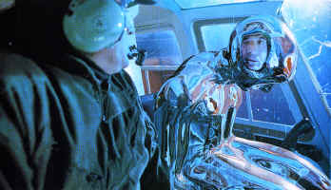
Environment Maps - Example
T1000 in Terminator 2 from Industrial Light and Magic

Slide 30
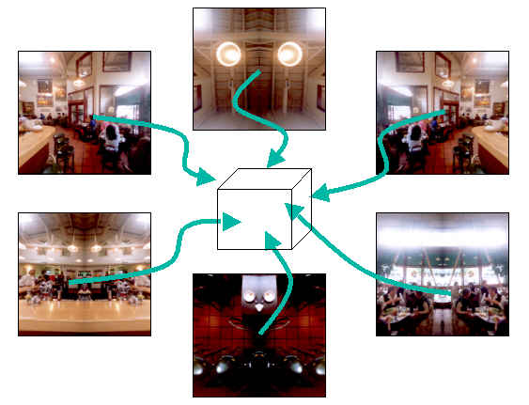
Cube Maps
Maps a viewing direction b and returns an RGB color
  Use stored texture maps

Slide 31
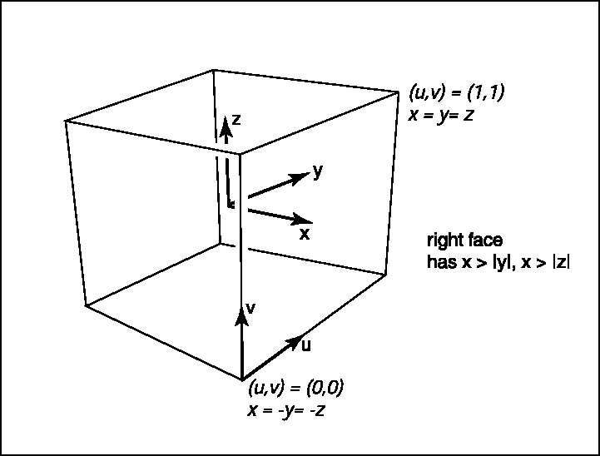
Cube Maps
Maps a viewing direction b and returns an RGB color
  Assume b = (x, y, z),
- Identify a face based on magnitude of x,y,z
-For the right face, compute texture coord. (u,v)
u = (y+x)/(2x)
v = (z+x)/(2x)
Notes:
Parameterize a line P(t) starting at P0(0, 0, 0) in the direction of (x, y, z)
Let the right face to be x=1 plane. Then, the intersection point, (1, x’, y’) become (tx, ty, tz).
So, x’ = y/x, y’ = z/x, where x’ and y’ ranges between -1 and 1).
After mapping them to (0, 1), we got the above equations.

Slide 32
Environment Maps - Problems
Expensive to update dynamically
Not completely accurate
  One of main reason that Cars (Pixar movie of 2006) used ray tracing
images from NVIDIA
Reflection of swimming pool is wrong
Notes:
Not completely accurate
Assumes that all reflected rays begin from the same point and all objects in the scene are the same distance from that point
May not represent the “near field” very well

Slide 33
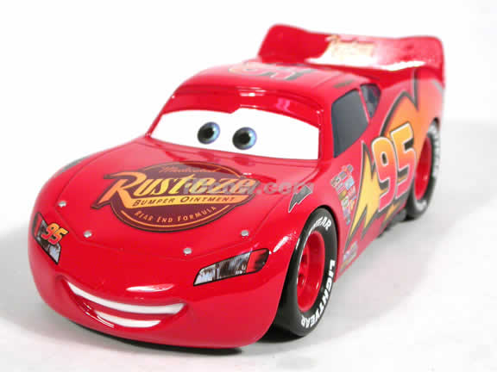
Environment Maps - Problems
Expensive to update dynamically
Not completely accurate
  One of main reason that Cars (Pixar movie of 2006) used ray tracing
Notes:
Not completely accurate
Assumes that all reflected rays begin from the same point and all objects in the scene are the same distance from that point
May not represent the “near field” very well

Slide 34
Modeling Geometry
Store complex surface details in a texture rather than modeling them explicitly
Bump maps
  Modify the existing normal
Normal maps
  Replace the existing normal
Displacement maps
  Modify the geometry
Opacity maps and billboards
  Knock-out portions of a polygon using the alpha channel

Slide 35
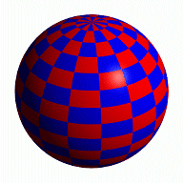
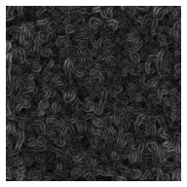
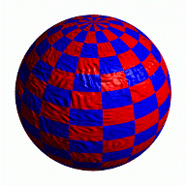
Bump Mapping
Modifies the normal not the actual geometry
  Texture treated as a heightfield
  Partial derivatives used to change the normal
  Causes surface to appear deformed by the heightfield
+
=

Slide 36
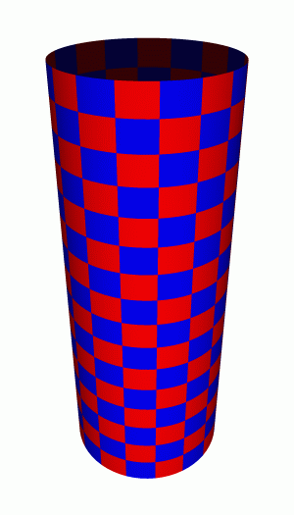
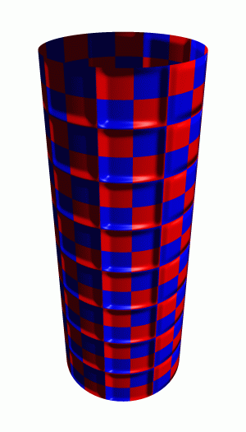

More Bump Map Examples
+
=
Note that silhouette edge of the object not affected!

Slide 37
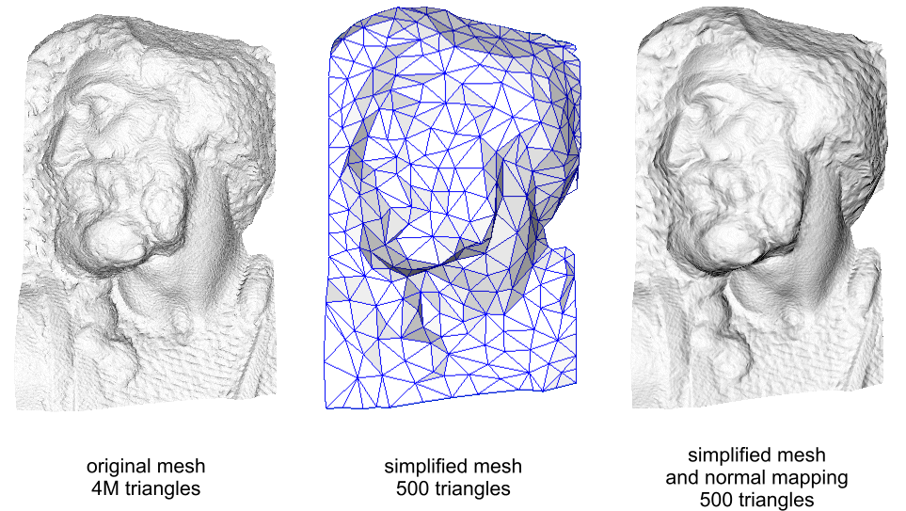
Normal Mapping
Replaces the normal rather than tweaking it

Slide 38
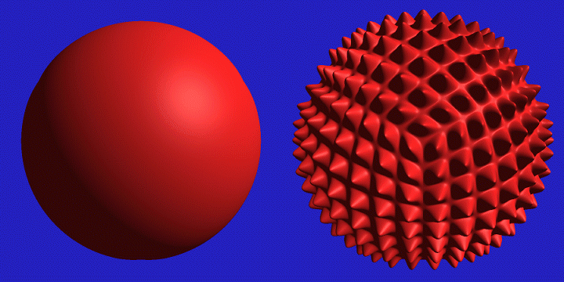
Displacement Mapping
Texture maps can be used to actually move surface points
The geometry must be displaced before visibility is determined
  Is this easily done in the graphics pipeline?

Slide 39
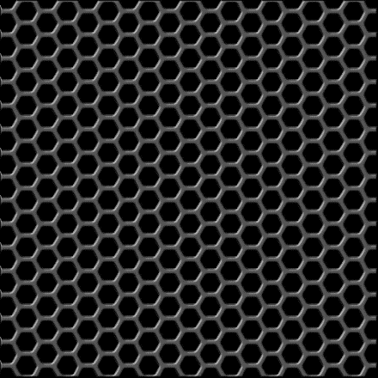
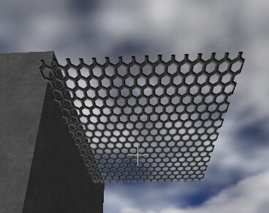

Opacity Maps
RGB channels
Use the alpha channel to make portions of the texture transparent
alpha channel

Slide 40
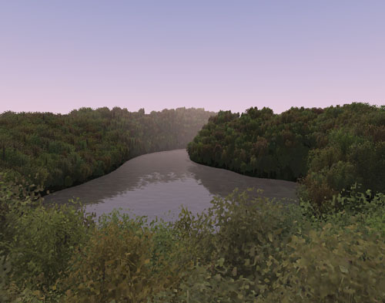
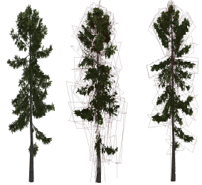
Billboards
Replace complex geometry with polygons texture mapped with transparent textures

Slide 41
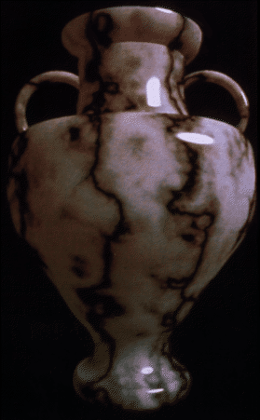
3D or Solid Textures
Solid textures are three dimensional assigning values to points in 3 space
  Very effective at representing some types of materials such as marble and wood
Generally, solid textures are defined procedural functions rather than tabularized functions as used in 2D

Slide 42
Class Objectives were:
Texture mapping overview
Texture filtering
Various applications of texture mapping

Slide 43
Next Time
Visibility and ray tracing

Slide 44
Homework
Go over the next lecture slides before the class
No more video abstract submissions on June

Slide 45
Figs

Slide 46
(x₄,y₄)
(u₄,v₄)
(x₃,y₃)
(u₃,v₃)
(x₁,y₁)
(u₁,v₁)
(x₂,y₂)
(u₂,v₂)

Slide 47
Texture space
Screen space
y
v
x
u

Slide 48
Handling Oversampling
sample
texture
Bi-linear interpolation

Slide 49




Summed-Area Tables
Original texture
Summed-area table
$$u_{0}$$
$$v_{1}$$
$$v_{0}$$
$$v_{1}$$

Slide 50
Shadow Maps
Depth map from eye
Depth map from light

Slide 51


Environment Maps
View
$$\vec{R}$$
$$E(\vec{R})$$
Spherical env. map

